Slide 1


ML Individual Assignment 1
Presented by Seo Shin Youn (S10205100K)
ML P04 Oct 2021 - Mr Zhou Weigui Jair
Notes:
[Speaker: Seo Shin Youn]
A very good morning to Mr Zhou and fellow classmates. My name is Shin Youn, and I will be presenting to you my Machine Learning Assignment 1 which consist of performing Exploratory Data Analysis; Data cleansing and transformation; before ending off with sharing the correlation analysis of the various features in both the HR analytics dataset and AirBNB dataset.

Slide 2

TABLE OF CONTENTS
Content Overview
01
Scope of Project for both HR Analytics & AirBnB
Chosen Machine Learning Model to be applied
Summary and Further Improvements
04
Findings of the two datasets
Possible further improvements
HR Analytics Classification Problem
02
Exploratory Data Analysis
Data Cleansing and Transformation
Correlation Analysis
05
References
AIRBNB Regression Problem
03
Exploratory Data Analysis
Data Cleansing and Transformation
Correlation Analysis
Notes:
[Speaker: Seo Shin Youn]
For this presentation,I will be covering the agenda and scope of work that I have done for both HR analytics and AirBNB dataset as well as the machine learning model that I had utilized for each of the classification and regression problem. Followingly, I will be covering more about the HR analytics dataset followed by the AirBNB dataset in terms of various data visualizations for problem understanding, data cleansing and transformation, before sharing more about my core findings based on the Correlation Analysis I had performed.

Slide 3
Content Overview
01
Scope of Project for both HR Analytics & AirBnB and the Chosen Machine Learning Model to be applied
Notes:
[Speaker: Seo Shin Youn]
Now I will be sharing more about the agenda for both the HR Analytics and AirBnB projects

Slide 4
Main Agenda - HR Analytics & AirBnB Dataset
Approach of cleansing and transforming data based on Neural Network ML model
As of Assignment 1 - Ordinal Encoding of both ordinal and nominal Categorical Variable Object Data Type
Not recommended for categorical values with no relationship
To be implemented in Assignment 2 - One Hot Encoding would be a better approach to encoding categorical values with no relationship
Primary focus of scaling/normalizing data
Mostly using Log Transformation
Most relevant numerical features are right-skewed in nature
Exclusively
HR Analytics (classification problem) - Stratified sampling to be performed
AirBnB (regression problem) - Focus on price prediction model for listings along EW line
[Further Explanation in Notes]
Notes:
[Speaker: Seo Shin Youn]
For both HR Analytics and AirBNB dataset, the data cleansing and transformation approach I had utilized is based on a Neural Network ML model instead of a Decision Tree that we are all familiar with.
Additionally, as of current Assignment, as we have only been taught how to utilize ordinal encoding, we would be using it in encoding the features with object data type. However, on thing to note would be that Ordinal Encoding is not a suitable approach for categorical variable object data type with no relationship to one another. This is because one value of a feature may not necessarily be bigger than the other value in the same feature. Hence, if we were to build the Neural Network model in assignment 2, a better suited approach would be to utilize One Hot Encoding instead which I would be implementing in the following assignment.
With One Hot Encoding, this is where the integer encoded variable is removed and a new binary variable is added for each unique integer value whereby there is no effect on the order. Furthermore, as we are using a Neural Network model, feature scaling would be necessary as if it is not being performed, a model with large weight values is often unstable, meaning that it may suffer from poor performance during learning and sensitivity to input values resulting in higher generalization error. Hence, with that being said the most commonly used normalization approach that I would be using would involve Log Transformation as we would later in see in further parts of the slides that many relevant numerical features in both dataset are positively skewed.
Hence, Log Transformation would be best equipped to handle positively skewed data. Last but not least, for the HR analytics classification problem exclusively, we would need to perform stratified sampling to ensure that the target variable has equal number of data on both side of the spectrum, making sure that each subgroup of interest is represented while our price prediction model of the AirBnB dataset would focus on listings along the East West Line.

Slide 5
HR ANALYTICS
Classification problem
02
2.1 Exploratory Data Analysis
2.2 Data Cleansing and Transformation
2.3 Correlation Analysis
Notes:
[Speaker: Seo Shin Youn]
Now I will be diving deeper into the HR Analytics classification problem, in the order of exploratory data analysis in unit 2.1, data cleansing and transformation in unit 2.2, and the analysis of correlation in unit 2.3.

Slide 6
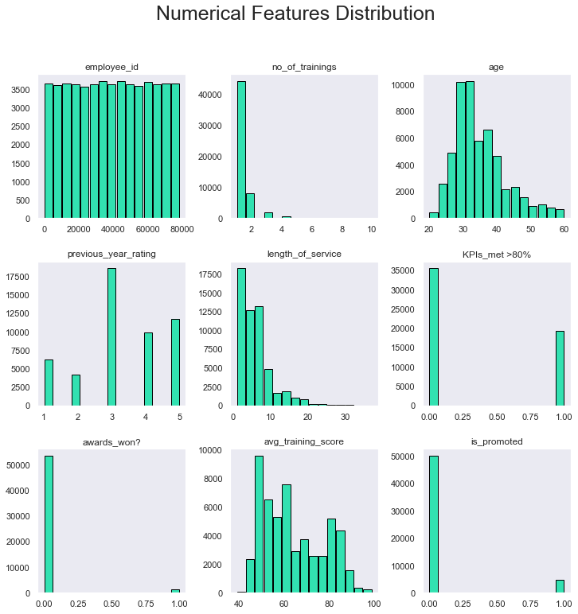
Unit 2.1 - Distribution of Numerical Features in HR Dataset
Main conclusions that can be drawn
Employee_id may be dropped as they are equally distributed in nature
Age, length_of_service, and avg_training_score are all positively skewed and have a large range as compared to other features.
May need to be normalized/scaled
Stratified sampling may need to be applied due to imbalance data of target variable
[Further Explanation in Notes]
Notes:
As a general overview of some conclusions that we can draw from the histogram, from the above chart of histograms representing the numerical features in the HR analytics dataset, we could narrow it down to analyzing the Age feature, Length of service, and average_training_score. Hence, from the chart, we could observe that these histograms are positively skewed in nature as seen from the tail of the data being located on the right hand side of the histogram. Additionally, as these features have a large range, we may need to scale and normalize these features. By looking at the histogram chart of our target variables, is_promoted, there is a large imbalance in domain values, and hence, we would need to apply stratified sampling on our target variable to ensure that there are equal number of data of equal importance.

Slide 7
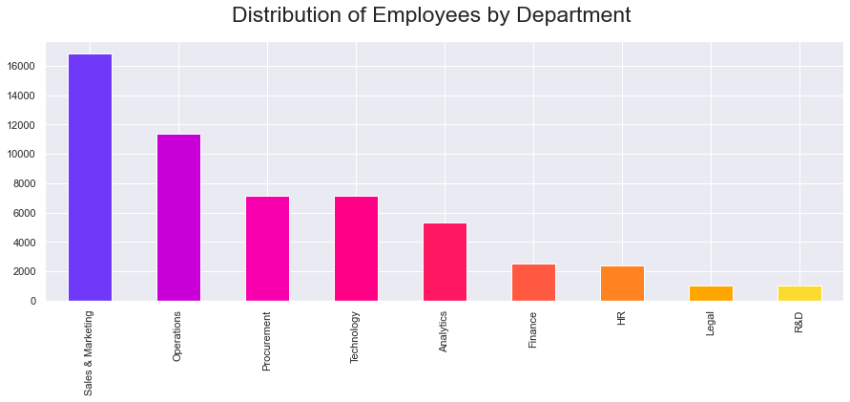
Unit 2.1 - Distribution of Employees across Departments
Most employees are from Sales & Marketing department with the least number of employees in legal/R&D departments

Slide 8
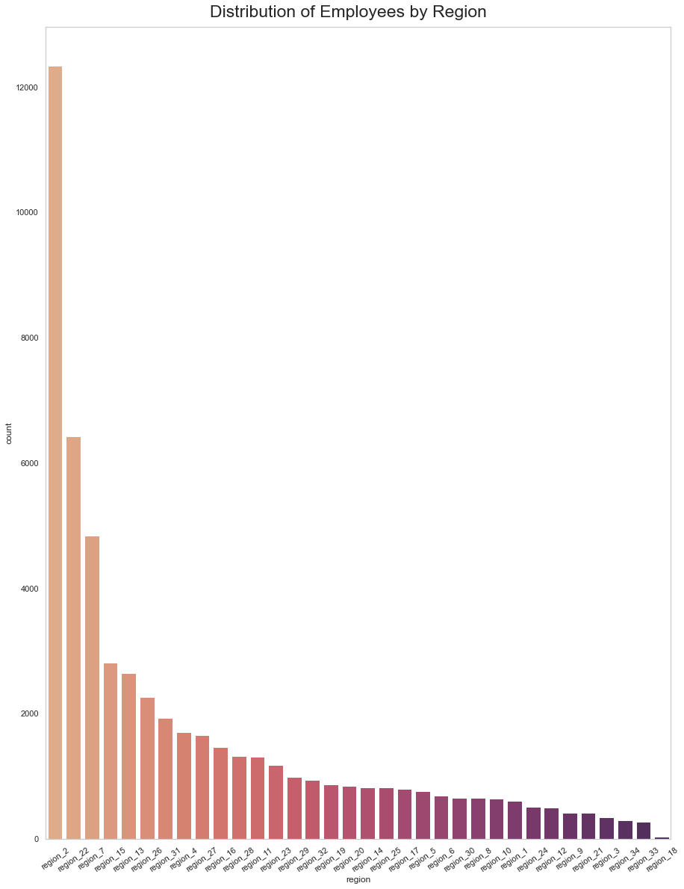
Unit 2.1 - Distribution of Employees across Regions
From the bar chart illustrating distribution of employees by region:
Region 2 has the largest number of employees (>12000 employees)
Followed by Region 22 and 7 respectively
Region 16 has the least number of employees
Majority of region have an employee count of <2000

Slide 9
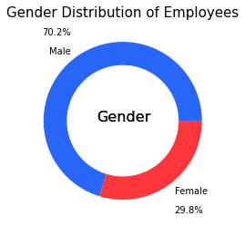
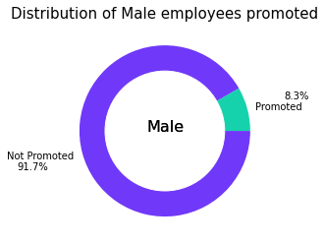
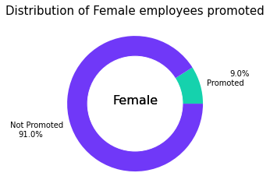
Unit 2.1 - How Gender of Employee differs in promotion?
Marginal difference
[Further Explanation in Notes]
Notes:
From the above visualization starting from the donut chart on the left, we could observe that there is significantly larger number of Male employees being employed represented by 70.2% as compared to the number of female employees which is represented by 29.8%. This may be due to the nature of the company whereby male employees prefer working such job or it may be a cause of unfair hiring practices. Additionally, from the donut charts on the left which shows the number of male employees and female employees that have received promotion, female employees have a marginally higher chance of receiving promotions of 9% while male employees slightly fall short with only 8.3% of them being promoted. Hence, we can observe that gender only has a minor significance in determining promotion.

Slide 10
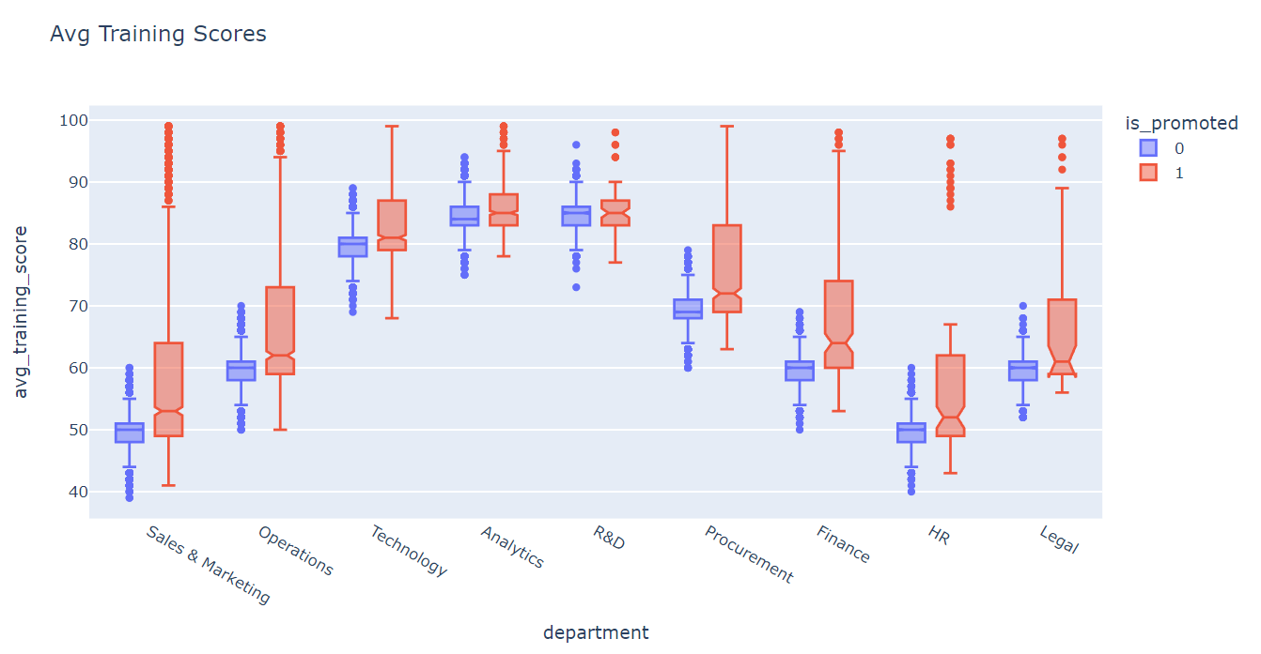
Unit 2.1 - Average training score of employees promoted/not across departments
[Further Explanation in Notes]
Notes:
From the above visualization chart illustrating the boxplot distribution across department against their average training score, irrespective of promotion, we could observe that among those in the Analytics, R&D, as well as Technology department, they have a higher average training score as compared to employees in the other department such as HR, and Sales and Marketing for instance. However, what is interesting is that we could observe that those in the Sales and Marketing department that have low training scores are nonetheless being promoted. This may observed due to factors that may not be found in the dataset such as the number of sales execution they have performed and sales they have brought into the company. Nonetheless across the various departments, we could observe that those that are being promoted have a higher median Average training score generally as compared to employees that were not promoted. Hence, we can conclude that average training score does play an important role in determining promotion.

Slide 11
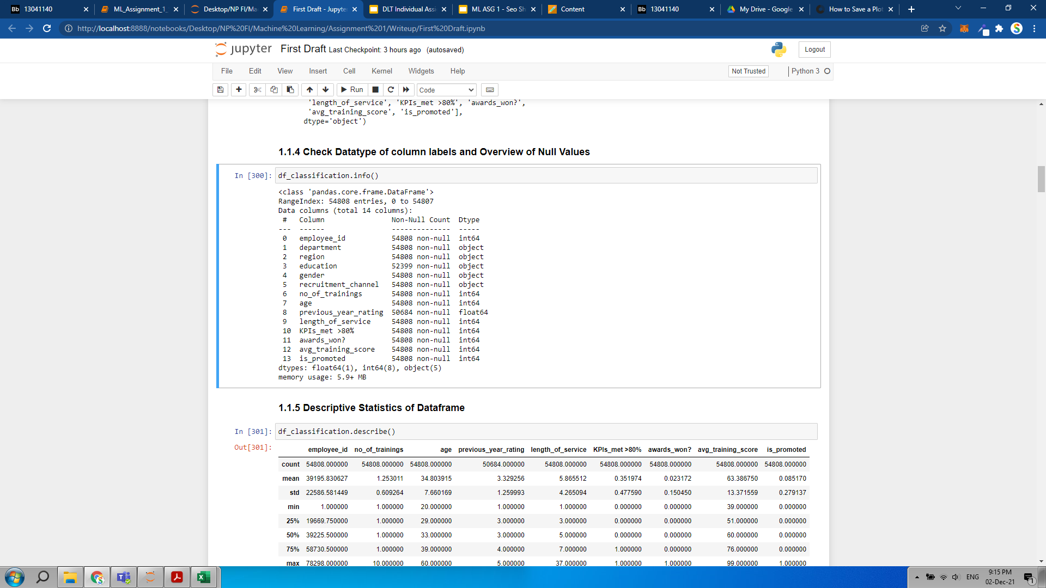
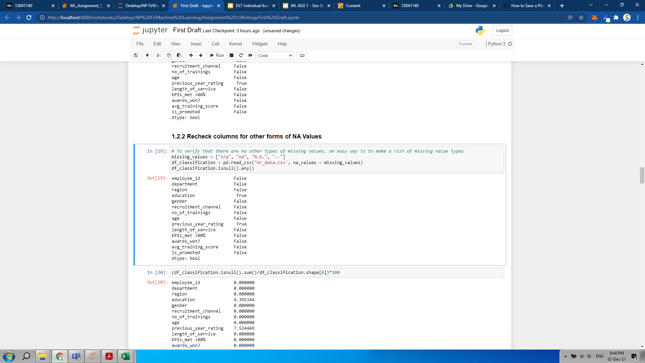
Unit 2.2 - Identifying Null Values in Dataframe
Presence of Null values in Education and Previous_year_rating column
Verifying other forms of commonly used null values including:
‘n/a’, ‘na’, ‘N.A.’, ‘--’ that pandas.DataFrame.info may overlook
Notes:
The first step in our data cleaning and transformation process would involve identifying the null values in our dataframe. Hence, from the above data frame we could observe that although the number of entries that has been identified is represented by 54808 entries. This is not the case for both the education and previous_year_rating column which only have 52399 records and 50684 records respectively. To further verify that these are the only columns with null values, we could perform a check on other commonly used null values such as ‘n/a’, ‘na’, ‘N.A.’, ‘--’ that pandas.DataFrame.info may not be able to detect. Hence, as only ‘True’ is shown on columns education and previous_year_rating we can verify that these are the only columns that have null values.

Slide 12
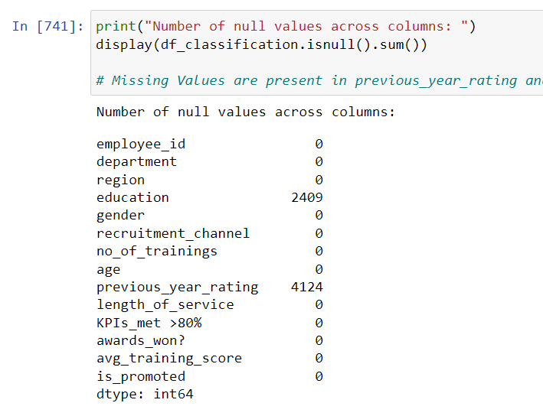
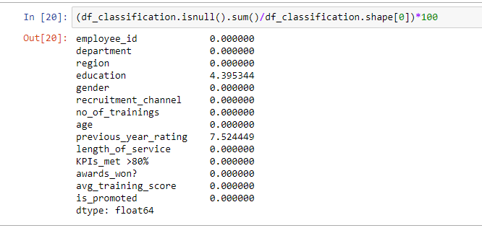
Unit 2.2 - Proportion of Null Values in Respective Columns
4.40% and 7.52% Null Values Present in Education
And Previous_year_rating respectively
2409 and 4124 Null Values Present in Education
And Previous_year_rating respectively
Notes:
To check the number of null values present in the previously identified column, we could use df.isnull().sum(). Thus, we could observe that education and previous_year_rating column have a null value of 2408 and 4124 respectively. Additionally, by dividing the number of null values by the number of expected records, we could observe that null values represent 4.40% of data in the education column while null values represent 7.52% of data in the previous_year_rating column. Thus, these percentage of null values that we observe are relatively small in nature and hence, no drastic measures would have to be taken.

Slide 13
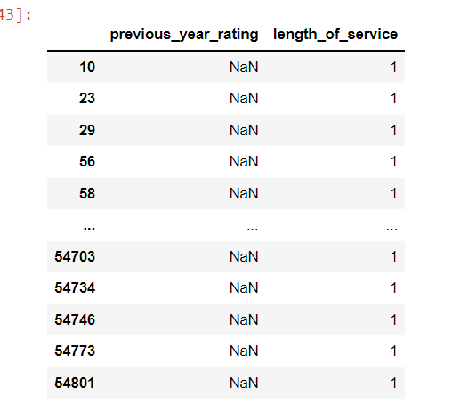
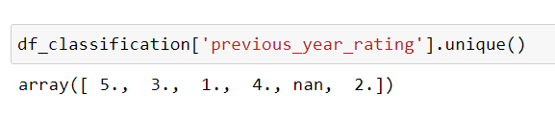
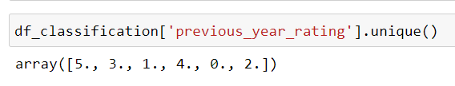
Unit 2.2 - ‘previous_year_rating’ missing data treatment
Data was not entered as employees had only 1 year of service.
No Data would have been there in the Data Source itself for these employees
Based on Business Logic, “0” would be imputed as the new employees would not have any previous_year_rating
Before imputation with “0”
After imputation with “0”
Notes:
To identify how we should perform missing value treatment, we can first analyze more about the dataset. Hence, based on further analysis, we could observe that for every null value in previous_year_rating column, they have a length_of_service of 1, irregardless of null record. Hence, it could be the case whereby these data entries are new employees which have only started working for the company and thus have only had a length_of_service of 1. Hence, it could be the case whereby the existing employees did not key in the previous_year_rating as no data would have been there. Thus, based on business logic, we could create a value of 0 to represent the value to be imputed into the null records as it is incorrect to input a valid record of 1.0 to 5.0 using other methods of imputation such as mean/median/mode.

Slide 14
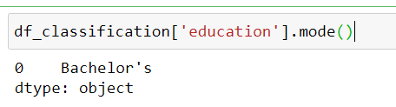
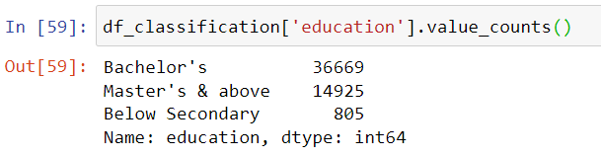
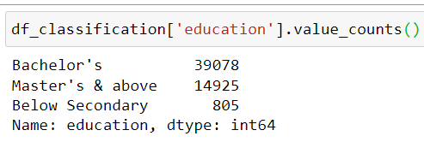
Unit 2.2 - ‘education’ missing data treatment
For NaN values in ‘education’ column, we will be imputing the mode as part of missing value treatment.
Mode = ‘Bachelor’s’
Before imputation with “Bachelor’s”
After imputation with “Bachelor’s”
Notes:
Additionally, to handle missing data in the ‘education’ column, we could use mode method of imputation, which in this case is represented by “Bachelor’s’ as other central tendency methods of imputation such as median and mean would only be able to handle numerical value. Hence, as ‘education’ is a categorical variable of ordinal value mode would be best utilized as it is able to handle both nominal and ordinal categorical value. Thus, from imputation of ‘Bachelor’s’ we could see that the number of employees who hold a Bachelor’s degree had increased from 36,669 to 39,078 which in itself already represents more than 60% of data.

Slide 15
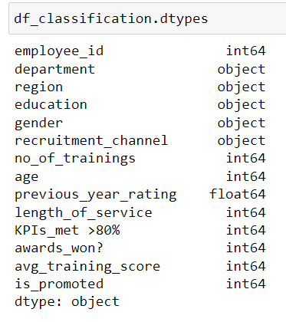


Unit 2.2 - Why Encoding Object Data Type is necessary?
Neural Network Models require that input and output variables are numbers.
Encoding categorical data is necessary to fit and evaluate the model
ASG1 - Ordinal Encoding for Neural Network Model:
Appropriate for categorical values that are ordinal in nature (e.g. education)
May not be appropriate for categorical values with no relationship as order is important in Neural Network (e.g. department)
ASG2 - One Hot Encoding to be implemented
Notes:
Moving forward, to utilise machine learning models, we would have to first handle categorical data by converting them to numbers. This is because machine learning models such as Neural Network that we would be using in future assignments require that input and output variable are numbers. This means that categorical data must be encoded to numbers before we can use it to fit and evaluate a model. Thus, we would need to convert all the object data type into a numerical feature. For assignment 1 as we had only learnt Ordinal encoding, we would be implementing it in building our machine learning neural network model. However, ordinal encoding is really only appropriate if there is a known relationship between the categories. In this case, we will ignore any possible existing ordinal relationship and assume all variables are categorical. It can still be helpful to use an ordinal encoding, at least as a point of reference with other encoding schemes. To take note however, this is an enormously naive way of handling the data and it usually serves no good other than to make it work particularly for categorical features whereby the values have no relationship and order, for example, department column. Hence, in Assignment 2, we may implement One Hot Encoding instead, as it is appropriate for categorical data where no relationship exists between categories.

Slide 16
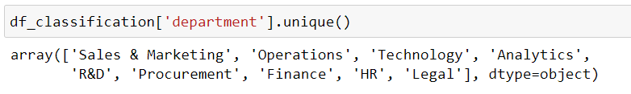
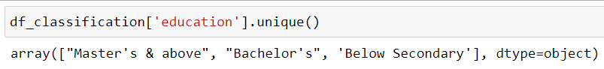
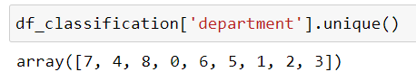
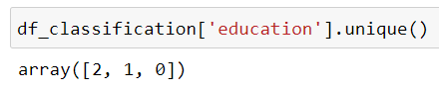
Unit 2.2 - Ordinal Encoding for Object Data Type Columns
Mapping of ‘Department’ Column
Mapping of ‘Education’ Column
Before Ordinal Encoding of ‘Department’ column:
Before Ordinal Encoding of ‘Education’ column:
After Ordinal Encoding of ‘Department’ column:
After Ordinal Encoding of ‘Education’ column:
Notes:
Hence, through ordinal encoding, we could observe that categories have been replaced starting from 0 up till the number of unique values in the categorical feature. As for ‘department’ column, which is regarded as a nominal categorical feature, there is no strict order in terms of value used to encode the value. Whereas for education column, as it is regarded as an ordinal categorical variable, I had assigned 0 to ‘Below Secondary’, followed by ‘Bachelor’s’, before ‘Master’s’ which is assigned a value of 2 given that ‘Master’s and above’ represent an advanced form of education by nature.

Slide 17
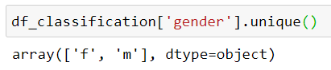
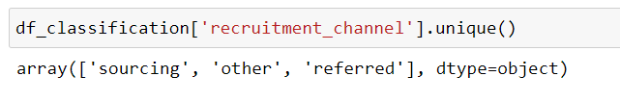
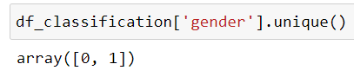
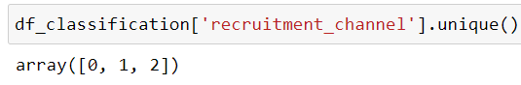
Unit 2.2 - Ordinal Encoding for Object Data Type Columns
Mapping of ‘Gender’ Column
Mapping of ‘recruitment_channel’ Column
Before Ordinal Encoding of ‘Gender’ column:
Before Ordinal Encoding of ‘recruitment_channel’ column:
After Ordinal Encoding of ‘Gender’ column:
After Ordinal Encoding of ‘recruitment_channel’ column:
Notes:
Given that for both Gender and Recruitment Channel column, that there is no strict order in terms of encoding the data, I had assigned 0 to the female gender while I had encoded a value of 1 to the male gender. Whereas, for recruitment channel column, I had assigned a value of 0 to ‘sourcing’ value, a value of 1 to ‘others, before encoding a value of 2 to the value ‘referred’.

Slide 18
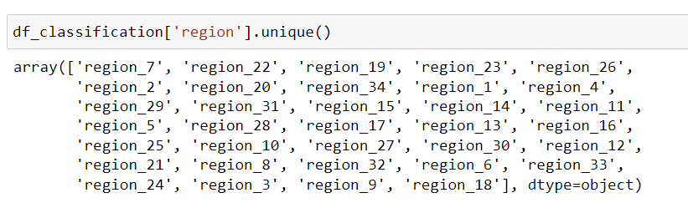
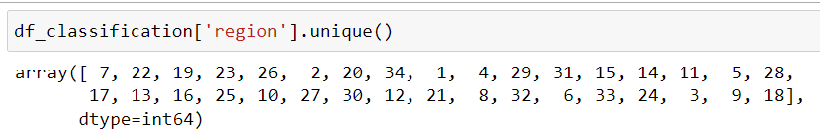
Unit 2.2 - Removing redundant value from String in Region Column
& Converting Region Column to Integer
Removing ‘region_’ string from ‘region_X’ + Convert to integer
After removing ‘region_’ and converting column to integer:
Notes:
As for the Region column that has an object datatype, I had firstly extracted the redundant string and underscore of region as it has been already implied in the name of the feature, ‘region’. Hence, with the region number being extracted as a string value, I had converted the column to an integer datatype. Thus, I would not have to perform any form of mapping as these data could be used in implementing a neural network ML model.

Slide 19

Unit 2.2 - Performing normalization/scaling of Data for Neural Network model
Why normalize/scale data for Neural Network Model?
Primary Focus
Without scaling, features that are big in scale (i.e. age, length_of_service, average_training_score) become dominating as a result → Prediction becomes inaccurate
With scaling, Neural Network has higher efficiency → Better Predictor
Normalization Technique to be used: Log Transformation
Log-Transformation: Best employed for correcting positively skewed data (𝑥^′=𝑙𝑜𝑔(𝑥+1))
log1p() method returns log(1+number)
To reverse back to original data we could use exp(x) - 1, the inverse of log1p.
Notes:
Another part of the data cleansing and transformation process that would be involved in the Neural Network model to be implemented would be ensure that the various column features are normalized and scaled. The goal of normalization is to change the values of numeric columns in the dataset to use a common scale, without distorting differences in the ranges of values or losing information. Normalization is also required for Neural Network model in particular. This is because, without scaling certain numerical features that are big in scale may dominate other numerical features that are relatively small in comparison. Hence, those features that are small by nature may not be of equal importance in determining whether an employee would likely be promoted or not which leads to inaccuracy in prediction. Thus, by normalizing/scaling data in a neural network model, higher efficiency is achieved as features are of equal importance, which promoted better accuracy in prediction.
The normalization technique that we would be using would be Log Transformation, this is because it is able to handle positively skewed data well. The important caveat here is that the original data has to follow or approximately follow a log-normal distribution which in this case we would see in the later slides. Additionally, by using the log1p() method, it produces only positive values and removes the 'danger' of large negative numbers. Last but not least, to interpret log1p(), we can reverse it back to original data by using exp(x) - 1, the inverse of log1p.

Slide 20
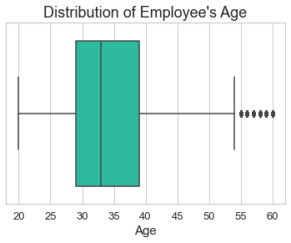
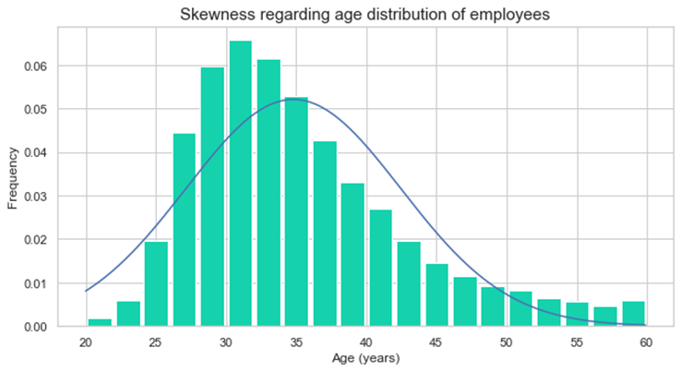
Unit 2.2 - Performing normalization/scaling of Data for Neural Network model (‘age’ column)
Both BoxPlot and histogram diagram shows that ‘Age’ data is positively skewed + Only a small number of outliers → Employ Log Transformation
Notes:
By plotting the Age column using a boxplot and histogram, we could observe that there are a small number of outliers represent and that the data is positively skewed in nature. Hence, we can employ Log Transformation to scale and normalize the distribution.

Slide 21
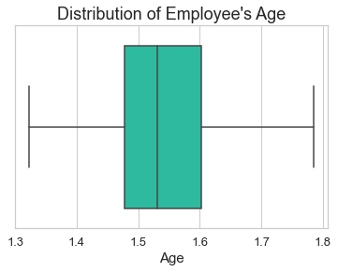
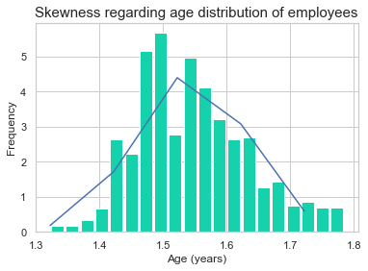
Unit 2.2 - Performing normalization/scaling of Data for Neural Network model (‘age’ column)
After Log Transformation:
Data is normalized (no skew) + No more outliers
Notes:
After performing log transformation on the age column, we could observe that there is little to no presence of skewness in data as the age column has been normalized successfully. Additionally, we had also fulfilled our secondary goal of eliminating outliers although it is not of importance in a neural network model. This is because the neural network is unaffected by the outliers impact when the percentage-outliers in the training data is lower than 15%.

Slide 22
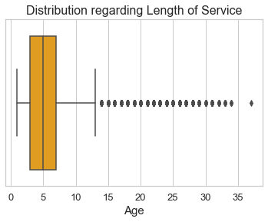
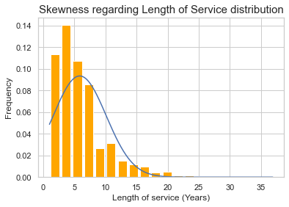
Unit 2.2 - Performing normalization/scaling of Data for Neural Network model (‘length_of_service’ column)
Both BoxPlot and histogram diagram shows that ‘length_of_service’ data is positively skewed + large number of outliers → Employ Log Transformation
Notes:
By plotting the length_of_service column using a boxplot and histogram, we could observe that there is a relatively larger number of of outliers present compared to the age column and that the data is positively skewed in nature as seen from the tail of data being located on the right hand side of the histogram. Hence, we can employ Log Transformation to scale and normalize the positively skewed distribution.

Slide 23
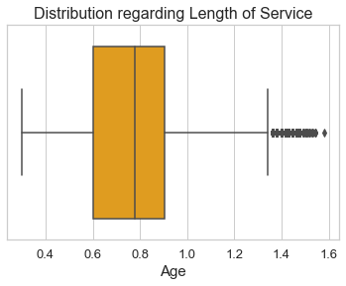
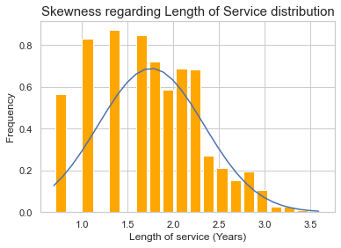
Unit 2.2 - Performing normalization/scaling of Data for Neural Network model (‘length_of_service’ column)
After Log Transformation:
Data is normalized (Reduced Skewness) + Reduction in extreme outliers
Notes:
After performing log transformation on the length_of_service column, we could observe that there is little to no presence of skewness in data as the length_of_service column has been normalized successfully. However, there are still presence of outliers although it is not of importance in a neural network model. This is because the neural network is unaffected by the outliers impact when the percentage-outliers in the training data is lower than 15%.

Slide 24
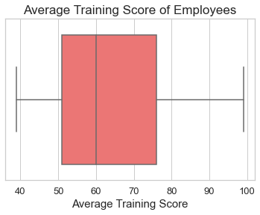
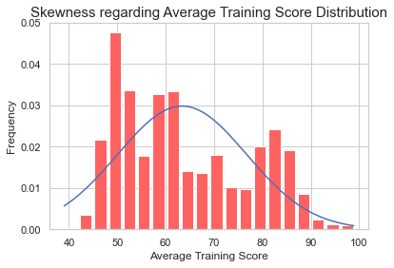
Unit 2.2 - Performing scaling of Data for Neural Network model
('Average Training Score' column)
Both BoxPlot and histogram diagram shows that ‘average_training_score’ data is positively skewed although no outliers → Employ Log Transformation
Notes:
By plotting the 'Average Training Score' column using a boxplot and histogram, we could observe that there is no presence of outliers compared to the age and length of service column and that the data is slightly positively skewed in nature as seen from the tail of data being located on the right hand side of the histogram. Hence, we can employ Log Transformation to scale and normalize the slightly skewed distribution.

Slide 25

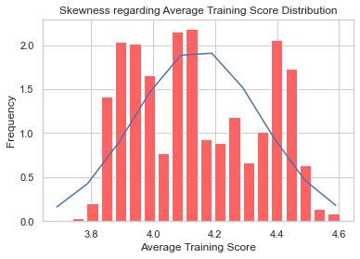
Unit 2.2 - Performing scaling of Data for Neural Network model
('Average Training Score' column)
After Log Transformation:
Data is normalized (Skewness is reduced)
Notes:
After performing log transformation on the avg_training_score column, we could observe that there is little to no presence of skewness in data as the avg_training_score column has been normalized successfully. This is evident from the fact that we could observe that the normal distribution follows that of a bell curve.

Slide 26
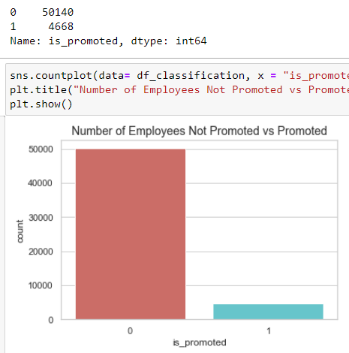
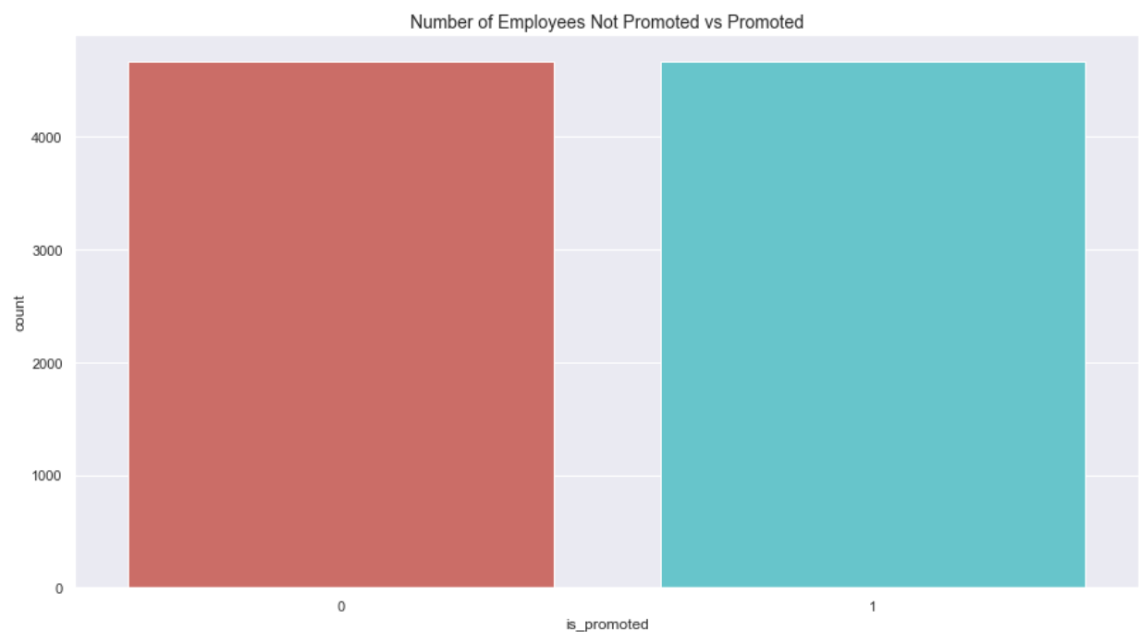
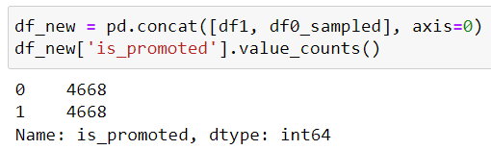
Unit 2.2 - Unbalanced Dataset (Perform Stratified Sampling)
A classification problem should have equal number of employees promoted vs not promoted
Achieved through Stratified Sampling
Notes:
By observing our target variables, is_promoted, there is a large imbalance in domain values, and hence, we would need to apply stratified sampling on our target variable to ensure that there are equal number of data of equal importance. This is evident from the fact that while there is 50,140 records of employees promoted, there are only 4,668 records present for those who had received promotion. Hence, by employing stratified sampling we could observe that the the number of records has been reduced to 4,668 for both employees who had/had not been promoted as evident from the count plot which illustrates an equal number or records.

Slide 27
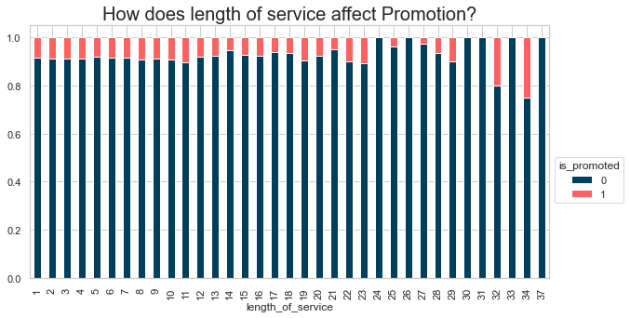
Unit 2.3 - Relevance of Previous Year Rating in determining promotion
For employees who had served for longer number of years, there is little relationship in whether he/she would be promoted
Conclusion: The ‘length_of_service’ feature is a slightly relevant indicator in determining promotion
Notes:
By observing the stacked bar chart, there is little evidence that the length_of_service column has a strong impact on promotion. This can be seen from between length of service between 1 year to 24 years whereby the proportion of those who were promoted neither increaser nor decreased. Hence, we can conclude that the ‘length_of_service’ feature is only a slightly relevant indicator in determining promotion.

Slide 28
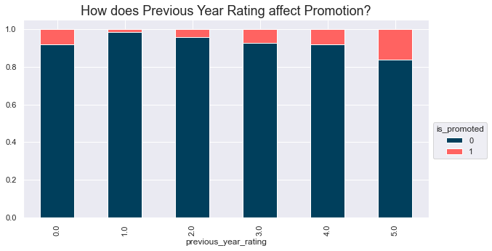
Unit 2.3 - Relevance of Previous Year Rating in determining promotion
For employees who had previously received a high rating, there is an increased likelihood that he/she would be promoted
Conclusion: The previous_year_rating feature is a moderately relevant indicator in determining promotion
Notes:
From the stacked bar we could observe that those who had attained a high rating in the previous year would have a chance of receiving a promotion. This is evident from the fact that as the previous year rating grew larger, the proportion of those who had been promoted had increased. Hence, we could conclude that the previous_year_rating feature is a moderately relevant indicator in determining promotion.

Slide 29
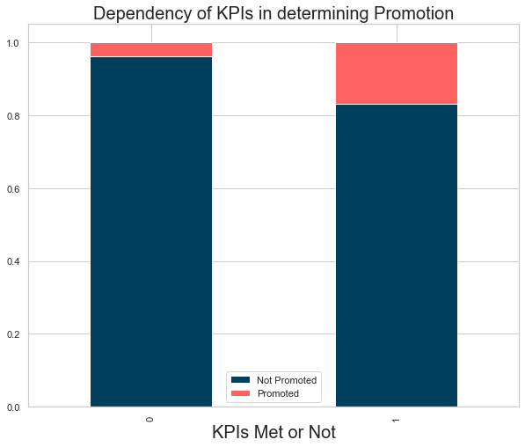
Unit 2.3 - Relevance of meeting KPI in determining promotion
For employees who have achieved a KPI > 80%, there is a slight increase in likelihood of receiving a promotion.
Conclusion: The KPI_Met_>80% feature is a moderately relevant indicator in determining promotion
Notes:
From the stacked bar we could observe that those who had attained a met the KPI indicator of >80& would have a higher likelihood of receiving a promotion. This is evident from the fact that compared to those who had not met the KPI, those had met the KPI had higher proportion of employees being promoted. Hence, we could conclude that the
The KPI_Met_>80% feature is a moderately relevant indicator in determining promotion.

Slide 30
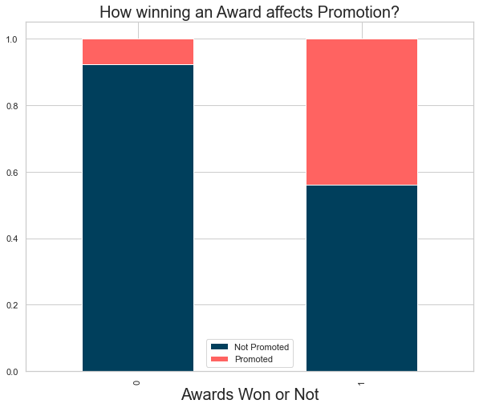
Unit 2.3 - Relevance of Awards in determining promotion
For employees who had previously won an award, there is a large increase in likelihood of receiving a promotion.
Conclusion: The awards_won? feature is a relevant indicator in determining promotion (i.e. close to 50% had received a promotion from winning an award)
Notes:
From the stacked bar chart, we could observe that those who had attained an award previously would have a higher likelihood of receiving a promotion. This is evident from the fact that compared to those who had not won an award, close to 50% of employees who had won an award had received a promotion while those that did not win an award had promotional rate of less than 10%. Hence, we could conclude winning an award is a strong and relevant indicator in determining promotion.

Slide 31
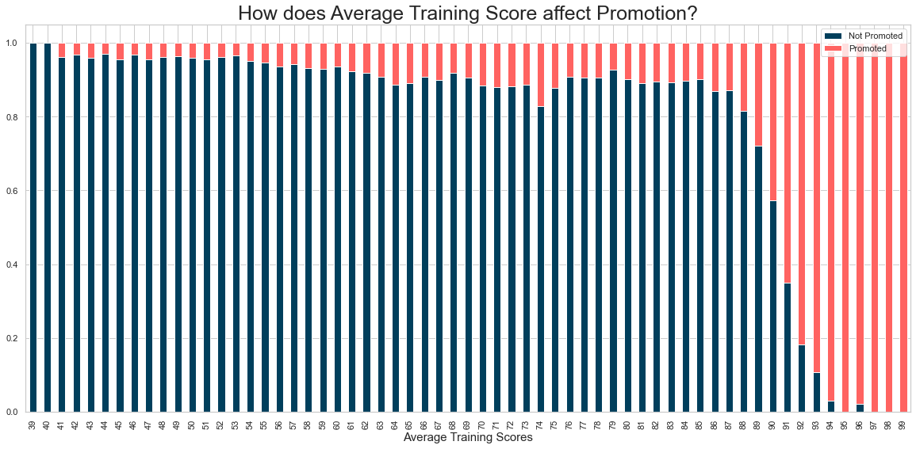
Unit 2.3 - Relevance of Average Training Score in determining promotion
For employees who have a high average training score, there is an increased likelihood of receiving a promotion.
Conclusion: The ‘avg_training_score’ feature is a relevant and strong indicator in determining promotion (97-99 score - All promoted, 39-40 - 100% None Promoted)
Notes:
Employees that had a high average training score are more likely to receive a promotion as compared to those who had received a low average training score. This is evident from the fact that as average training increase from 85 to 99, the proportion of employees that had been promoted had increased disproportionately. Whereas the same can also be said for those who had a low training score of 39 to 40 whereby no one had been promoted. Thus we can conclude that the ‘avg_training_score’ feature is a strong and relevant predictor in determining promotion.

Slide 32
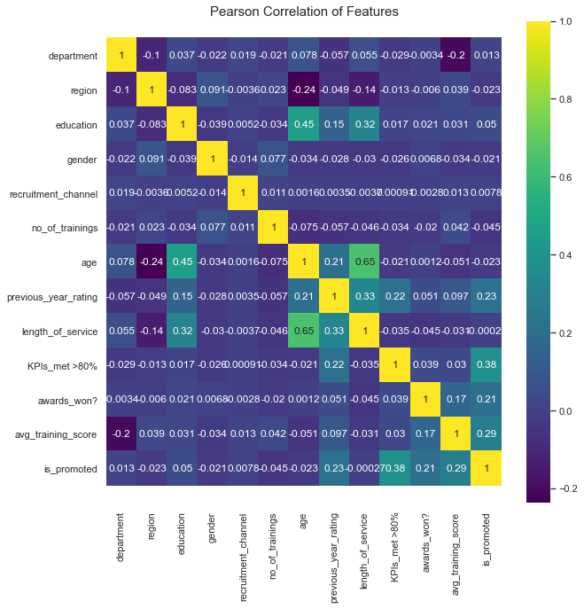
Unit 2.3 - Pearson Correlation Heatmap & Scatter Matrix
Features with positive correlation with Target Variable ‘is_promoted’:
Previous_year_rating (0.23)
KPIs_met>80% (0.38)
Awards_won? (0.21)
Avg_training_score (0.29)
Age and length_of_service are highly correlated
Age and education are highly correlated

Slide 33
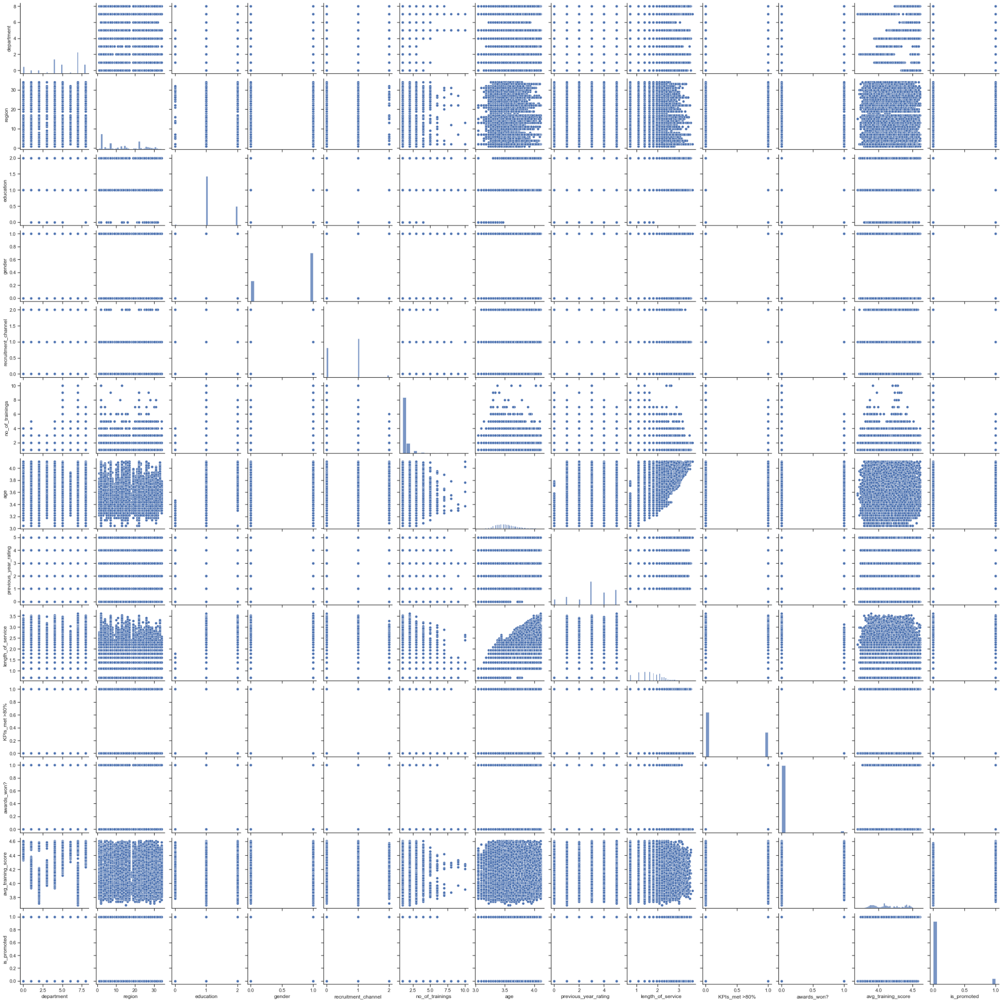
Unit 2.3 - Pearson Correlation Heatmap & Scatter Matrix
No interesting observations can be made from
The scatter matrix

Slide 34
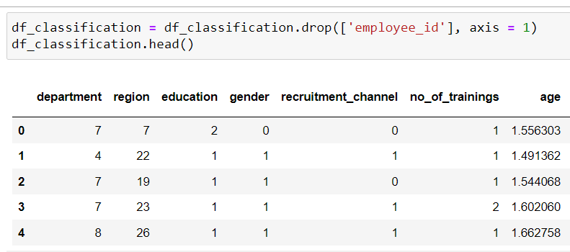
Unit 2.3 - Redundant Features in building Neural Network model
‘Employee_id’ column dropped - The column is independent and identically distributed. Hence, they do not affect the target variable.
Notes:
The feature that we had dropped involves ‘Employee_id’. This is because Employee_ID is a unique value that is equally and identically distributed. Hence, it is a independent variable that does not affect the chance of an employee being promoted as our target variable. Thus, I had dropped the column asit is unnecessary in our Neural Network Machine learning model.

Slide 35
AIRBNB
Regression problem
03
Exploratory Data Analysis
Data Cleansing and Transformation
Correlation Analysis
Notes:
[Speaker: Seo Shin Youn]
Now I will be diving deeper into my analysis of the AIRBNB Regression problem, in the order of exploratory data analysis in unit 3.1, data cleansing and transformation in unit 3.2, and the analysis of correlation in unit 3.3.

Slide 36

Unit 3.1 - Distribution of Numerical Features in AIRBNB Dataset
Main conclusions that can be drawn
Minimum_nights, number_of_reviews, reviews_per_month, calculated host listings are all positively skewed and have a large range as compared to other features.
May need to be normalized/scaled.
Why Binning is not recommended?
Introduces arbitrary assumptions in analysis
Loss of information
[Further Explanation in Notes]
Notes:
As a general overview of some conclusions that we can draw from the histogram; from the above chart of histograms representing the numerical features in the AirBNB dataset, we could narrow it down to analyzing the Minimum_nights, number_of_reviews, reviews_per_month, and calculated host_listings_count features. Hence, from the chart, we could observe that these histograms are positively skewed in nature as seen from the tail of the data being located on the right hand side of the histogram while data is being unevenly distributed. Additionally, as these features have a large range, we may need to scale and normalize these features. However, one of the methods that I have evaluated that would not be recommended would involve binning the features to produce equal distributions. This is because by binning the data, we are introducing arbitrary assumptions in analysis which would also result in the loss of information as it is an irreversible process.

Slide 37

Unit 3.1 - Relationship of various regions in AIRBNB Dataset
Distribution of Room Listings offered on AirBnB
Entire home/apartment listings are most preferred (52.3%)
Shared room listings is less preferred in Singapore (4.98%)
[Further Explanation in Notes]
Notes:
From the above donut chart, we could observe that the most popular room listing method would be to rent out an entire home or apartment (52.3% of data) followed by listing out a private room (42.8%), while the least preferred listing method would be to rent out a shared room (4.98%).

Slide 38

Unit 3.1 - Relationship of various regions against price in AIRBNB Dataset
Shared Room pricing are relatively cheaper in nature as compared to Private room/Entire home/apt listings
Private Room/Entire home/apt listings have a higher dispersion in pricing compared to Shared Rooms

Slide 39


Unit 3.1 - Relationship of various regions in AIRBNB Dataset
Scatterplot Distribution longitude vs latitude
across neighbourhood regions
Number of listings across regions
The Central Region is the popular listing neighbourhood group
[Further Explanation in Notes]
Notes:
From the scatter plot distributions of the longitude and latitude, we could observe the map of Singapore across the various neighbourhood regions including the North Region, Central Region, East Region, West Region, and North-East Region. Additionally, by observing the count plot, we could observe that the Central Region has a significantly larger amount of listings of above 6000 while the number of listings across other regions fall short with less than 1000 listings each. Hence, we can conclude that the central region is a popular listing neighbourhood group to host.

Slide 40

Unit 3.1 - Relationship of various regions against price in AIRBNB Dataset
Central Region has the most expensive accommodation (Highest median of above $100)

Slide 41


Unit 3.2 - Identifying Null Values in Dataframe
Presence of Null values in name, last_review,
and reviews_per_month column
Verifying other forms of commonly used null values including:
‘n/a’, ‘na’, ‘N.A.’, ‘--’ that pandas.DataFrame.info may overlook
Notes:
The first step in our data cleaning and transformation process would involve identifying the null values in our dataframe. Hence, from the above data frame we could observe that although the number of entries that has been identified is represented by 7907 entries, this is not the case for the name column, last_review column, and reviews_per_month column which only have 7095 records, 5149 records, and 5149 records respectively. To further verify that these are the only columns with null values, we could perform a check on other commonly used null values such as ‘n/a’, ‘na’, ‘N.A.’, ‘--’ that pandas.DataFrame.info may not be able to detect. Hence, as only ‘True’ is shown on columns name, last_review, and reviews_per_month we can verify that these are the only columns that have null values.

Slide 42


Unit 3.2 Proportion of Null Values in Respective Columns
Presence of 2 Null values in name, and 2758 Null Values
in both last_review, and reviews_per_month column
Null Values constitute 0.025% of name, while a staggering 34.88% of Null Values is present in both last_review, reviews_per_month
Notes:
To check the number of null values present in the previously identified column, we could use df.isnull().sum(). Thus, we could observe that the name column, last_review column, and reviews_per_month column have a null value of 2, 2758, and 2758 respectively. Additionally, by dividing the number of null values by the number of expected records, we could observe that null values represent 0.025% of data in the name column while null values represent a staggering 34.88% of data in both the last_review and reviews_per_month column.

Slide 43

Unit 3.2 Dropping of redundant features and ‘name’
Missing Value Treatment
Unique Identifiers to be dropped: ‘id’, ‘name’, ‘host_id’, ‘host_name’
Listing IDs are equally distributed and independent of the target variable → Not a suitable predictor in determining price
No meaningful data could be derived from ‘name’, ‘host_id’, ‘host_name’ to further understand data
Latitude and Longitude
Suitable in performing data understanding
Not suitable in predicting price target
Notes:
To treat the 2 missing values in ‘name’ column, we could perform a drop of the ‘name’ column as no meaningful data could be derived from them. Similarly, columns such as ‘id’, ‘name’, ‘host_id’, as well as ‘host_name’ could also be removed. Particularly, for ‘id’, as it is equally distributed and independent of the price target variable, it is not a suitable predictor in determining the price. Thus, as we had eliminated the following columns, we would not have to treat the missing data in the ‘name’ column. Additionally, although the latitude and longitude are useful columns in terms of helping us pinpoint the exact location, they are not suitable for use in predicting price target as such data could already be derived from both ‘neighbourhood’ column.

Slide 44


Unit 3.2 ‘last_review’ Transformation & Missing Value Treatment
To obtain further insight into the last_review date, we could transform it to the number of days since last_review
Step 1:
Calculate number of days between today’s date and date record
After column transformation and imputation:
Step 2:
Fill NaT values with median number of days
Step 3:
Conversion to integer required
Notes:
Moving on, to treat the null values in ‘last_review’ column, we would firstly be performing a feature transformation so that we could derive the number of days since the last_review in order to have a better representation and understanding of the column. Hence, as the ‘last_review’ column is a string object data type, we could first convert it into a datetime object for us to calculate the number of days between today’s date and the data recorded. Hence, by doing so, we could use the median number of days to fill NaT values before converting the column into a integer datatype. Hence, we could observe that records with null values have been imputed with 892 as the number of days since the last_review.

Slide 45



Unit 3.2 ‘review_per_month’ Missing Value Treatment
Mean imputation not suitable due to positively-skewed distribution → Imputation with Median
0.55 (median) would be imputed to rows with null values
Notes:
To treat the missing values in the ‘review_per_month’ column we could use imputation with median value of the column as by observing the distribution of the column, it is positively skewed in nature. Hence, this makes it unsuitable to use mean as the value of imputation given that it may be excessively inflated given that it is sensitive to extreme observations. Thus, we could instead use the median of 0.55 as the value of imputation for null records. Hence, by using the isna().values().any() methods, we could observe that the the null values have been successfully imputed.

Slide 46



Unit 3.2 Focus on Subset of Region in Price Prediction Model
Chosen Regions in ‘neighbourhood_group’ to Focus on building Price Prediction model:
Properties along East-West Line of Singapore: West Region, Central Region, East Region
Rows of Regions to be removed in dataframe:
North Region, North-East Region
Notes:
Moving further, as we would like to create a customized price prediction model instead of a generic price prediction model, we could instead utilize a subset of region to focus on. Thus, for this Neural Network Machine learning model, I had decided to focus on the neighborhood group including the west region, central region, and East region which forms the property listings across the East-West MRT Line of Singapore. This is because it allows me to maintain a large dataset from the central region while reducing the scope of the region in my customized price prediction model. Hence, for this project, I had dropped rows that had neighbourhood group from the North and North East Region.

Slide 47



Unit 3.2 Focus on subset of price range in price prediction model
A large number of outliers can be found in our target variable, ‘price’, causing skewness in our finding if not handled
Normalization not needed on Target variable (no impact on result)
Using Interquartile Range (IQR) to remove outliers
After IQR Outlier removal
(Q1-1.5*IQR < x < Q3+1.5*IQR) or (-136.0, 400.0):
Notes:
Additionally, to further create an effective customized price prediction model, I had also decided to focus on a subset of data for the price column, particular for prices that fall within the IQR range. This is because there is a large number of outliers present in the price target variable, which leads to a skewed distribution. Additionally, given that normalization would not be needed on a target variable as it does not have to be scaled down to other features, I had decided to use Interquartile Range method to detect and remove outliers. Hence, for my price prediction model, only rows that falls above 1.5 times the first quartile and below 1.5 times the third quartile would be kept or within 0 to 400 dollars to be exact.

Slide 48

Unit 3.2 - Ordinal Encoding for Object Data Type Columns
Neural Network Models require that input and output variables are numbers.
Encoding categorical data is necessary to fit and evaluate the model
ASG1 - Ordinal Encoding for Neural Network Model:
Appropriate for categorical values that are ordinal in nature
May not be appropriate for categorical values with no relationship as order is important in Neural Network
ASG2 - One Hot Encoding to be implemented
Notes:
Moving forward, to utilise machine learning models, we would have to first handle categorical data by converting them to numbers. This is because machine learning models such as Neural Network that we would be using in future assignments require that input and output variable are numbers. This means that categorical data must be encoded to numbers before we can use it to fit and evaluate a model. Thus, we would need to convert all the object data type into a numerical feature. For assignment 1 as we had only learnt Ordinal encoding, we would be implementing it in building our machine learning neural network model. However, ordinal encoding is really only appropriate if there is a known relationship between the categories. In this case, we will ignore any possible existing ordinal relationship and assume all variables are categorical. It can still be helpful to use an ordinal encoding, at least as a point of reference with other encoding schemes. To take note however, this is an enormously naive way of handling the data and it usually serves no good other than to make it work particularly for categorical features whereby the values have no relationship and order. Hence, in Assignment 2, we may implement One Hot Encoding instead, as it is appropriate for categorical data where no relationship exists between categories.

Slide 49




Unit 2.2 - Ordinal Encoding for Object Data Type Columns
Mapping of ‘neighbourhood_group’ Column
Mapping of ‘neighbourhood’ Column
Before Ordinal Encoding of ‘neighbourhood_group’ column:
Before Ordinal Encoding of ‘neighbourhood’ column:
After Ordinal Encoding of ‘neighbourhood_group’ column:
After Ordinal Encoding of ‘neighbourhood’ column:
Notes:
As the ‘neighbourhood_group’ column would be considered a nominal data, there would not be any strict order in which the values are being mapped. Hence, for West Region, I had encoded it to a value of 0 while I had encoded a value of 1 and 2 to the Central Region and East Region respectively. Similarly for the ordinal encoding of ‘neighbourhood’ column, as there are no particular relationship and order between the various neighbourhood, there would not be any strict order in which the values are being mapped.

Slide 50


Unit 2.2 - Ordinal Encoding for Object Data Type Columns
Mapping of ‘room_type’ Column
Before Ordinal Encoding of ‘room_type’ column:
After Ordinal Encoding of ‘room_type’ column:
Notes:
As for the mapping of the ‘room_type’ column, given that it is likely that ‘Shared room’ would be the cheapest among the various room, while an Entire home / apartment would be at the opposite end of the spectrum in terms of pricing, I had encoded the values in a strict order such that ‘Shared room’ is encoded to a value of 0, with ‘Private room’ mapped to a value of 1 and lastly with ‘Entire home/apt’ being mapped to a value of 2.

Slide 51




Unit 3.2 Outlier Detection/Scaling of numeric features using Boxplot
Summary of Findings:
Reviews per month, number of reviews, minimum nights, number of listings by hosts are all positively skewed
Reviews per month, number of reviews, and minimum nights → Large number of outliers
Number of listings by host → Small number of outliers
Perform Log Transformation to normalize and scale data
Binning method would not be utilized as it would introduce arbitrary assumptions and lead to loss of meaning
Notes:
By plotting the boxplot distributions of the various numerical columns with a large range of data, we could observe that for the columns of Reviews per month, number of reviews, minimum nights, number of listings by hosts, they all are positively scaled by nature, such that for Reviews per month, number of reviews, and minimum nights they have a Large number of outliers while listings by host has a small frequency of outliers. Hence, we could perform log transformations to normalize and scale the data. Additionally, binning would not be used as we would be introducing arbitrary assumptions in analysis which would also result in the loss of information as it is an irreversible process.

Slide 52



Unit 3.2 - Performing normalization/scaling of Data for Neural Network model (‘reviews_per_month’ column)
Before performing Log Transformation:
After performing Log Transformation:

Slide 53



Unit 3.2 - Performing normalization/scaling of Data for Neural Network model (‘number_of_reviews’ column)
Before performing Log Transformation:
After performing Log Transformation:

Slide 54



Unit 3.2 - Performing normalization/scaling of Data for Neural Network model (‘minimum_nights’ column)
Before performing Log Transformation:
After performing Log Transformation:

Slide 55


Unit 3.2 - Performing normalization/scaling of Data for Neural Network model (‘calculated_host_listing_count’ column)
Before performing Log Transformation:
After performing Log Transformation:

Slide 56

Unit 3.3 - Pearson Correlation Heatmap
Features with positive correlation with Target Variable ‘price’:
Room_type (0.61)
Features including reviews_per_month and number_of_reviews are positively correlated (0.6)
Calculated_host_listings_count and availability_365 are positively correlated (0.43)
Last_review and reviews_per_month are negatively correlated (-0.44)
Number_of_reviews and reviews_per_month are negatively correlated to minimum_nights
(-0.26, -.24 respectively)

Slide 57

Unit 3.3 - Scatter Matrix

Slide 58
Summary of Findings
04
Findings of the two datasets
Possible further improvements
Notes:
[Speaker: Seo Shin Youn]
Thus, based on the challenges I have identified from the perspective of businesses worldwide...

Slide 59
Summary of Findings HR Analytics Dataset
The Sales & Marketing Department has the largest number of employees
Region 2 has the largest number of employees
Although more males are employed compared to females + Females have a marginally higher rate of getting promoted
The top 3 department with the highest average training score belongs to the:
Technology, Analytics, and R&D Department
Strong Indicators of promotion: Average Training Score, Winning of Awards, Meeting KPIs>80%, previous_year_rating
Neutral indicators of promotion: Gender, Length_of_service

Slide 60
Summary of Findings AirBNB Dataset
Entire home/apartment listings are most preferred with the least preferred method of listing being shared rooms
Shared Room pricing are relatively cheaper compared to private room/entire home/apt pricing with the least dispersion in pricing
Central Region represents the largest amount of listings among other regions
Central Region has the highest median price distribution among other regions
Room Type and Neighbourhood group are relatively strong indicator in determining price
As the number of minimum nights increases, the number of reviews and reviews per month given are lesser

Slide 61
References
05
APA 7th Edition Citation
Notes:
[Speaker: Seo Shin Youn]
Thus, based on the challenges I have identified from the perspective of businesses worldwide...

Slide 62
References (APA 7th Edition)
Buettgenbach, M. H. (2021, February 24). Python statistics for beginners - Towards Data Science. Medium. https://towardsdatascience.com/python-statistics-for-beginners-pearson-correlation-coefficient-69c9b1ef17f7
Lianne & Justin @ Just into Data. (2021, May 3). Data Cleaning in Python (2020): the Ultimate Guide | Towards Data Science. Medium. https://towardsdatascience.com/data-cleaning-in-python-the-ultimate-guide-2020-c63b88bf0a0d
Real Python. (2021, July 28). Pythonic Data Cleaning With Pandas and NumPy. https://realpython.com/python-data-cleaning-numpy-pandas/
Santoyo, S. (2018, June 21). A Brief Overview of Outlier Detection Techniques - Towards Data Science. Medium. https://towardsdatascience.com/a-brief-overview-of-outlier-detection-techniques-1e0b2c19e561
Saxena, S. (2020, August 16). 8 Categorical Data Encoding Techniques to Boost your Model in Python! Analytics Vidhya. https://www.analyticsvidhya.com/blog/2020/08/types-of-categorical-data-encoding/
Sharma, M. (2018, November 3). Data Visualization using Seaborn - Towards Data Science. Medium. https://towardsdatascience.com/data-visualization-using-seaborn-fc24db95a850
What Is a Decision Tree? (2021, June 18). Master’s in Data Science. https://www.mastersindatascience.org/learning/introduction-to-machine-learning-algorithms/decision-tree/
Yadav, D. (2020, February 8). Categorical encoding using Label-Encoding and One-Hot-Encoder. Medium. https://towardsdatascience.com/categorical-encoding-using-label-encoding-and-one-hot-encoder-911ef77fb5bd
Yadav, P. (2019, September 23). Decision Tree in Machine Learning - Towards Data Science. Medium. https://towardsdatascience.com/decision-tree-in-machine-learning-e380942a4c96

Slide 63
THANK YOU!
Notes:
[Speaker: Seo Shin Youn]
With that, I have come to the end of my presentation, and thank you for your kind attention!

